Slide 1
LSTM Core Implementation

Slide 2
LSTM
Long short-term memory (LSTM) or “LSTMs” is an artificial recurrent neural network (RNN) architecture used in the field of deep learning.
LSTM networks have a characterized feedback connection and are capable of processing not only single data points but entire sequences and series of data.
A common LSTM unit is composed of a cell, an input gate, an output gate and a forget gate.
The cell remembers values over irregular time intervals and the three gates regulate the flow of information into and out of the cell.
LSTM networks are well-suited to classifying, processing and making predictions based on time series data, since there can be lags of unknown duration between important events in a time series

Slide 3
So, why take the LSTM Approach?

Slide 4

ARIMA
Autoregressive integrated moving average (ARIMA) model is a generalization of ARMA model.
The AR part involves regressing the variable on its own lagged (i.e. past) values.
The MA part involves modeling the output variable linearly on the current and various past values of a stochastic (imperfectly predictable) term.
The I stands for "integrated" indicating that the data values have been replaced with the difference between their values and the previous values
ARIMA models are fitted to time series data to either better understand the data or to predict future points in the series.
ARIMA models are applied in some cases where data show evidence of non-stationarity
We want in principle “a stationary series that has no trend, its variations around its mean have a constant amplitude, and it wiggles in a consistent fashion” to implement ARIMA

Slide 5
Limitations of ARIMA in contrast to Neural Networks
ARIMA models are basically linear models, so they can only work if the relation is linear or linear integrated.
Although they are easy to estimate ARIMA yields better results only in forecasting short term, whereas LSTM yields better results for long term modeling.
LSTM can model more or less any relationship, but at the cost of additional computation and require more data to be trained.
LSTM add the capability of identifying complex pattern logics from data by using remember what's useful and discard what's not
Neural networks add the capability to learn possibly noisy and nonlinear relationships with arbitrarily defined but fixed numbers of inputs
Explicitly handling of ordered observations and is able to adapt itself to learn the temporal dependencies from context

Slide 6
Overview into LSTM’s prime advantage for our Dataset
LSTM have the capability of bridging long time lags between inputs
Since we are dealing with debit card data, that has irregularized patterns of randomness and cost fluctuation, LSTM is an effective approach as it is able to pattern the irregularity in past fluctuations and provides better results in the long-term forecast.
The LSTM approach provides a lot of flexibility in approaching the problem in contrast to ARMIA by providing us with a good control over several parameters of the time series and
Allowing use to choose between several combinations of seq2seq LSTM models to forecast the time-series - many to one model (predict at the current timestep given all the previous inputs), many to many model (predict multiple future time steps at once given all the previous inputs) and other such variations on these.
LSTM’s also allows us to further customize parameters such as - the size of look-back window to predict at the current step, the number of time steps we want to predict into the future, feeding the current prediction back into the window.
That is why, we have chosen the LSTM approach to create a prediction for this time series dataset.

Slide 7
Steps I’ve taken to build the LSTM to map our model
1) Remove the outliers from the dataset
The first step we take to adapt the LSTM model to our dataset, is to first remove the outliers i.e. values that are considered erroneously small or big to possibly be in concordance with the normality of the dataset. These outliers lie in the (+-) 3 sigma bounds of the distribution of the data and have to be removed. We do this by calculating the z score from the data and removing those values that do not lie in the acceptable range of the dataset.
2) Transform the time series into a supervised learning problem
For the time series problem, we can achieve this by using the observation from the last time step (t-1) as the input and the observation at the current time step (t) as the output. To facilitate this, we will use Panda libraries shift function to push all values in a series down by a specified number of places.
3) Make the series stationary
This step is important to ensure that the structure in the data that is dependent on the time and displays trends/ seasonality is removed and we have a stationarity set of values since stationary data is easier to model. We will ensure our series is stationary by using the diff function in the Pandas library to create a differenced series

Slide 8
4) Transform the Series to Scale
LSTMs expect data to be within the scale of the activation function used by the network. Since the default activation function for LSTMs is the hyperbolic tangent (tanh), which outputs values between -1 and 1 we take that as the preferred range for the time series data. We then transform the dataset to the range [-1, 1] using the MinMaxScaler class.
5) Fitting the Model
We run the model for a learning cycle with a Batch Size: 1, Epochs: 3000 (Determined by increasing until loss in accuracy i.e. Minimum RMSE score) and Neurons: 4 for training the model.
The batch size must be set to 1 as it must be a factor of the size of the training and test datasets. The predict function on the model is also set to 1 because we are interested in making one-step forecasts on the test data. Since we want the LSTM network to build up state as it learns across the sequence of observations. We can disable the shuffling of samples by setting the shuffle to “FALSE”
6) Forecasting with the LSTM Model
Once the LSTM model is fit to the training data, we can use it to make the forecasts. To forecast the fuel price data set, we will take the fixed approach that fits the model once on all of the training data, then predict each new time step one at a time from the test data.

Slide 9
Evaluating the Result

Slide 10
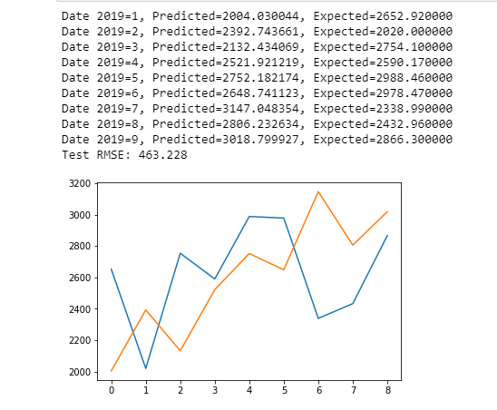

Slide 11
Conclusion
The reason for choosing RMSE is that for each point it calculates the square difference between the predictions and the target and then averages those values.
The higher this value, the worse the model is. Using RMSE shows us the marked error in the scale of our dataset hence makes it easier to analyze the error margin and gives us the average disparity amongst all the errors.
Thus, LSTM proved to be quite instrumental in helping us predict the forecast of this dataset, we can further improve this model by increasing the dataset size and further fine tuning the parameters to take into consideration factors such as statistical significance, lag features, error series and early stopping.

